Slide 1
SMART PARKING BASED ON
[IOT]
CONSIDERING A INTEGRATING CAMERA
BASED SOLUTION FOR IMAGR PROCCESSING

Slide 2
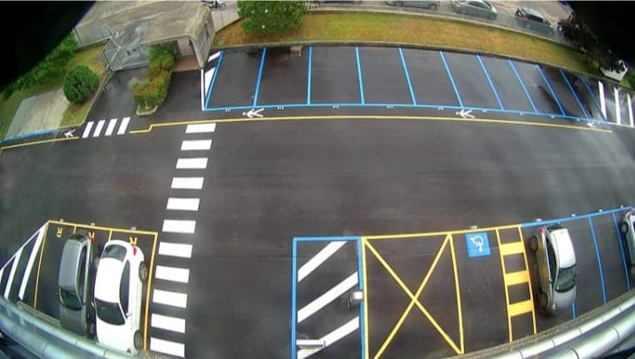
INTRODUCTION:
Smart parking system can greatly benefit airports management by improving efficiency and reducing cost. Our contribution can be summarized as follows:

Slide 3
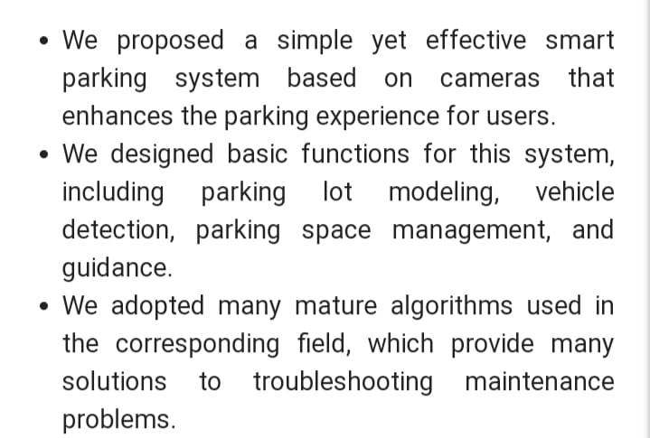
OVERALL PURPOSE IN SMART PARKING:

Slide 4
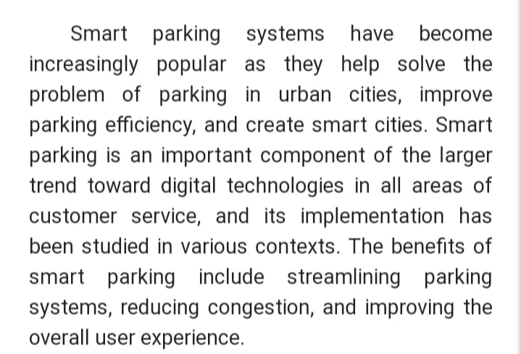
RELATED WORKS:

Slide 5
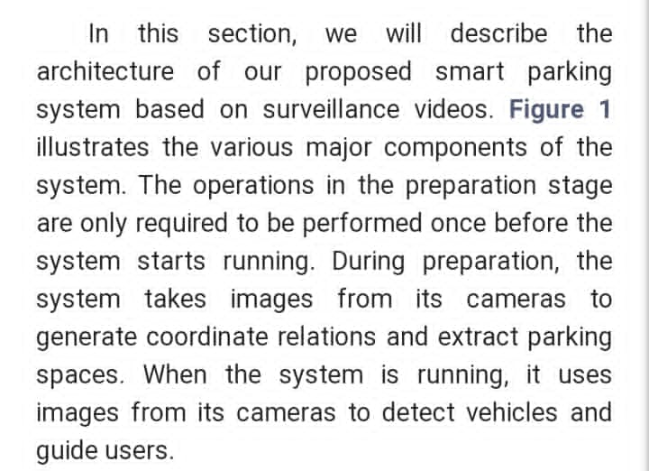
SYSTEM ARCHITECTURE:

Slide 6
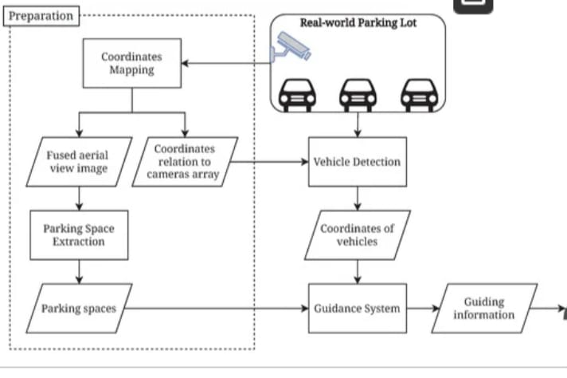
USER
USER

Slide 7
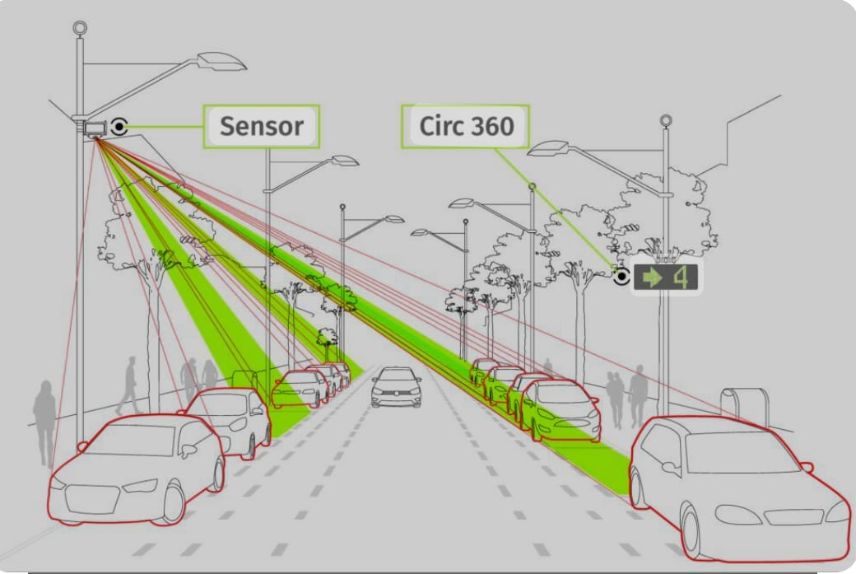

Slide 8
Conclusion:
IOT Based parking systems are able to better track the availability of parking spots on given Iot, making it easier to find a available parking spot.

Slide 9
PRESENTED BY:
KOWSALYA.M
MOULIKA.S
BHARATHI.S
RENUGA.K
ROSHINI.M

Slide 10
THANK YOU

